Slide 1
TUN Project
Daniel Gutierrez
Yasmin Atassi
Jesse Asare-Addo
Jamil Atassi
Archana Ravishankar

Slide 2
Overview
Questions:
Do our monthly donors give for a year and then lapse, or do they give over the course of a few years?
And do our monthly donors who give more than one year increase their gift amount year over year?

Slide 3
Problem and motivation
Analyze the frequency and amount of donations to see which donors should receive gifts to thank them for their donations
According to the data provided from Hire Heroes, donations ranged from $0.90 to $8,523,500.00 over 12 years.
If Hire Heroes wants more donations, then they can look into sending their big/frequent donators a gift as an incentive to donate more.

Slide 4
Approach
Our main focus was to increase donations by rewarding donors with thank you gifts.
Set a base donation amount that would warrant a gift
Focus on referencing columns headings with the Lifetime Donation History Amount and Number and total times donated.

Slide 5
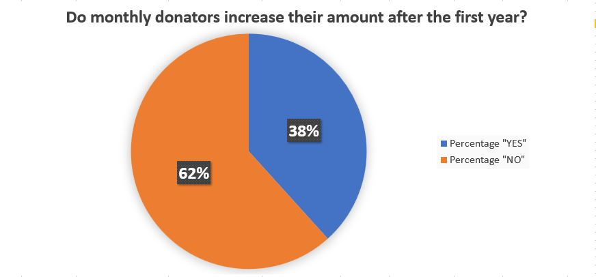
Tools and Analytics
Excel
Change and filter the years.
Calculate the amount per year and amount of donators
Tableau Prep and Desktop
Account ID = ID for Salesforce Account=Salesforce Opportunity
Types of donors

Slide 6
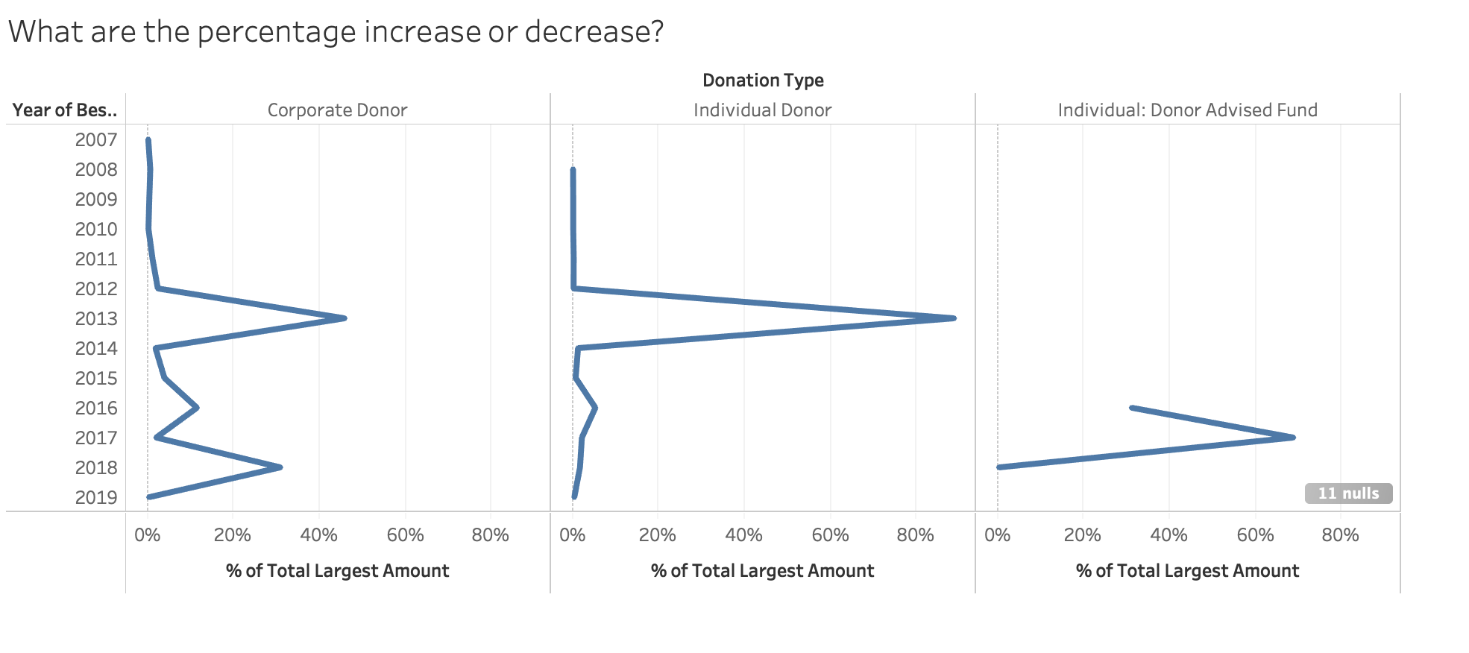

Slide 7
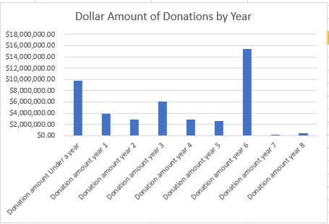
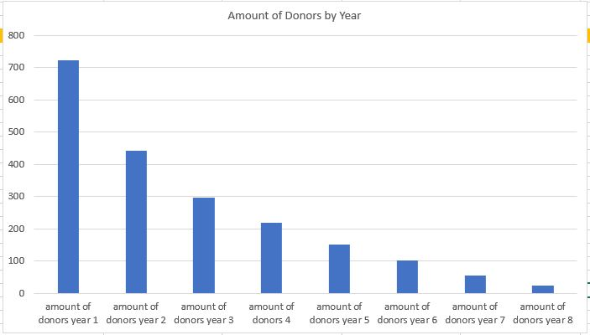
Results
The amount that donors, who donated more than one year, was actually reported to decrease over time.
It is also important to note that not only did the amount donated decrease, but also the number of donors themselves decreased throughout the seven years.

Slide 8
Suggestions
Find new donors for the future
Follow up with previous and current donors
If Hire Heroes are looking for more donations then they need to find lots of new donors
Have Hire Heroes provide data with all cells filled out

